Slide 1
On the Cost of Soundness for Gradual Typing

Slide 2
Why gradual typing is useful
Combines typed and untyped code
Annotations improve code readability
Eliminate type errors from typed code
Detect type errors between typed/untyped code

Slide 3
Classic soundness definition
Let 𝝘 ℯ : 𝞃 then
1- ℯ reduces to 𝓋 with type 𝞃
2- ℯ diverges
3- ℯ signals an error from a well-defined set of exceptions

Slide 4
Soundness for Reticulated Python
Let 𝝘 ℯ : 𝞃 then
1- ℯ reduces to 𝓋 with type 𝞃
2- ℯ diverges
3- ℯ signals an error from a well-defined set of exceptions

Slide 5
Soundness for Reticulated Python
Let 𝝘 ℯ : 𝞃 then
1’- ℯ reduces to some 𝓋 with type tag ⌊𝞃⌋
2- ℯ diverges
3- ℯ signals an error from a well-defined set of exceptions

Slide 6
Soundness for Reticulated Python
Let 𝝘 ℯ : 𝞃 then
1’- ℯ reduces to some 𝓋 with type tag ⌊𝞃⌋
2- ℯ diverges
3- ℯ signals an error from a well-defined set of exceptions
4- ℯ raises an exception that points to a set of boundaries between typed and untyped code.

Slide 7
Cost of soundness for gradual typing
To implement soundness Reticulated inserts runtime checks
These checks impose a cost on our program

Slide 8
Research question: what is the cost?

Slide 9
Reticulated python
We conduct the experiment for Reticulated Python
Reticulated is sound gradual typing for python

Slide 10
What are we trying to accomplish from our method?
Capture the overhead of adding type annotations to our program
We want exhaustive evaluation

Slide 11
Exhaustive evaluation
For some program, we consider the set of all ways we can add/remove types
We let every element in the set be a configuration
Can demonstrate the configurations using a lattice

Slide 12
Performance Lattice
𝛕
𝛕
𝛕
λ
λ
𝛕
N = 2
λ
λ

Slide 13
Adapting to Reticulated
Reticulated supports fine granularity
We can type class field, function argument, function return
Too many configurations
We choose to type more components at once. Function signatures and class fields.

Slide 14
Takikawa et al. method applied to Reticulated
We start with a set of programs
Type all function signatures and class fields
Generate all configurations
Measure the performance

Slide 15
Fully typed
@fields({'x': Int, 'y':Int})
class Point:
def __init__(self:Point,x:Int,y:Int)->Void:
self.x = x
self.y = y
def add(self:Point, other:Point)->Point:
x = self.x + other.x
y = self.y + other.y
return Point(x,y)

Slide 16
Representing the results: Overhead plots
(D-deliverable) A configuration in a performance lattice is D-deliverable if its performance is no worse than an Dx slowdown compared to the untyped configuration.

Slide 17
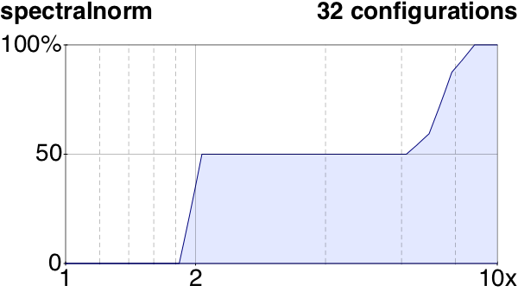
Overhead plots (spectral norm)
% of types
Values of D

Slide 18
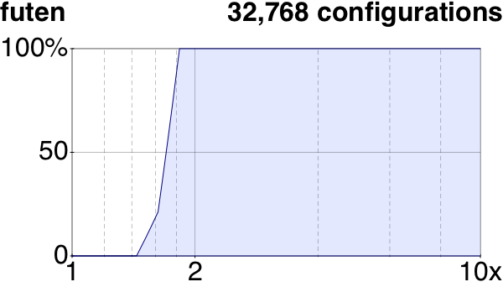
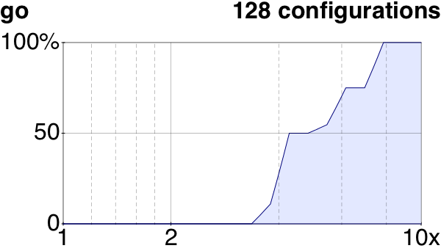
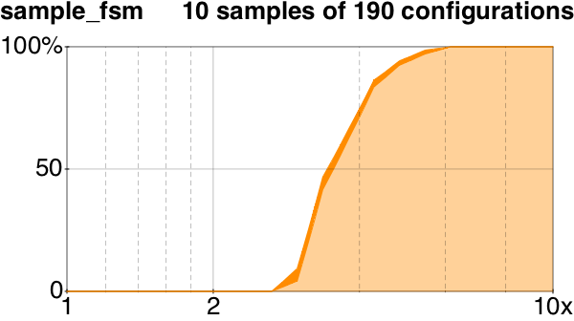
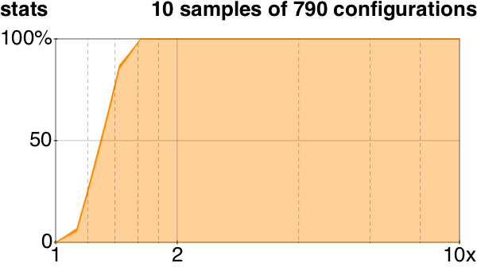
More plots (exhaustive & sampling)

Slide 19
Interpreting the plots
Steep slope : good
Shallow slope : Bad

Slide 20
Performance results (TR)
futen
http2
showSHA
call_method
call_method_slots
call_simple
chaos
fannkuch
float
go
1
3
2
7
8
3
3
1
3
7
meteor
nbody
nqueens
pidigits
pystone
spectralnorm
Espionage
PythonFlow
take5
2
1
1
1
2
8
5
7
1

Slide 21
Performance results (TR)
futen
http2
showSHA
call_method
call_method_slots
call_simple
chaos
fannkuch
float
go
1
3
2
7
8
3
3
1
3
7
meteor
nbody
nqueens
pidigits
pystone
spectralnorm
Espionage
PythonFlow
take5
2
1
1
1
2
8
5
7
1
All benchmarks are less than 10-deliverable
9 benchmarks are 2-deliverable

Slide 22
Performance results (TR)
5
10
27
1527
233
2
5
1
1
1
quadBG
quadMB
sieve
snake
suffixtree
synth
take5
tetris
zombie
zordoz
4
139
43
32
29
47
1
34
292
1
acquire
dungeon
forth
fsm
fsmoo
gregor
kcfa
Inm
mbta
morsecode

Slide 23
Performance results (TR)
5
10
27
1527
233
2
5
1
1
1
quadBG
quadMB
sieve
snake
suffixtree
synth
take5
tetris
zombie
zordoz
4
139
43
32
29
47
1
34
292
1
acquire
dungeon
forth
fsm
fsmoo
gregor
kcfa
Inm
mbta
morsecode
Worst benchmark is 100-deliverable

Slide 24
Alternative Soundness: example code

Slide 25
Alternative Soundness: example code
def make_strings()--> List(String):
xs = []
for i in range(3):
if i == 0:
xs.append(i)
elif i == 1:
xs.append([True])
else:
xs.append(make_strings)
return xs
make_strings()

